Slide 2
Notes:
The idea of talking to the dead seems to fascinate many today. It’s the subject of movies, novels, and even children’s literature. Books on mediums and their activities top the best-seller lists. It seems that communication with another world, or with those who were once among us, captivates the imagination of many.

Slide 3
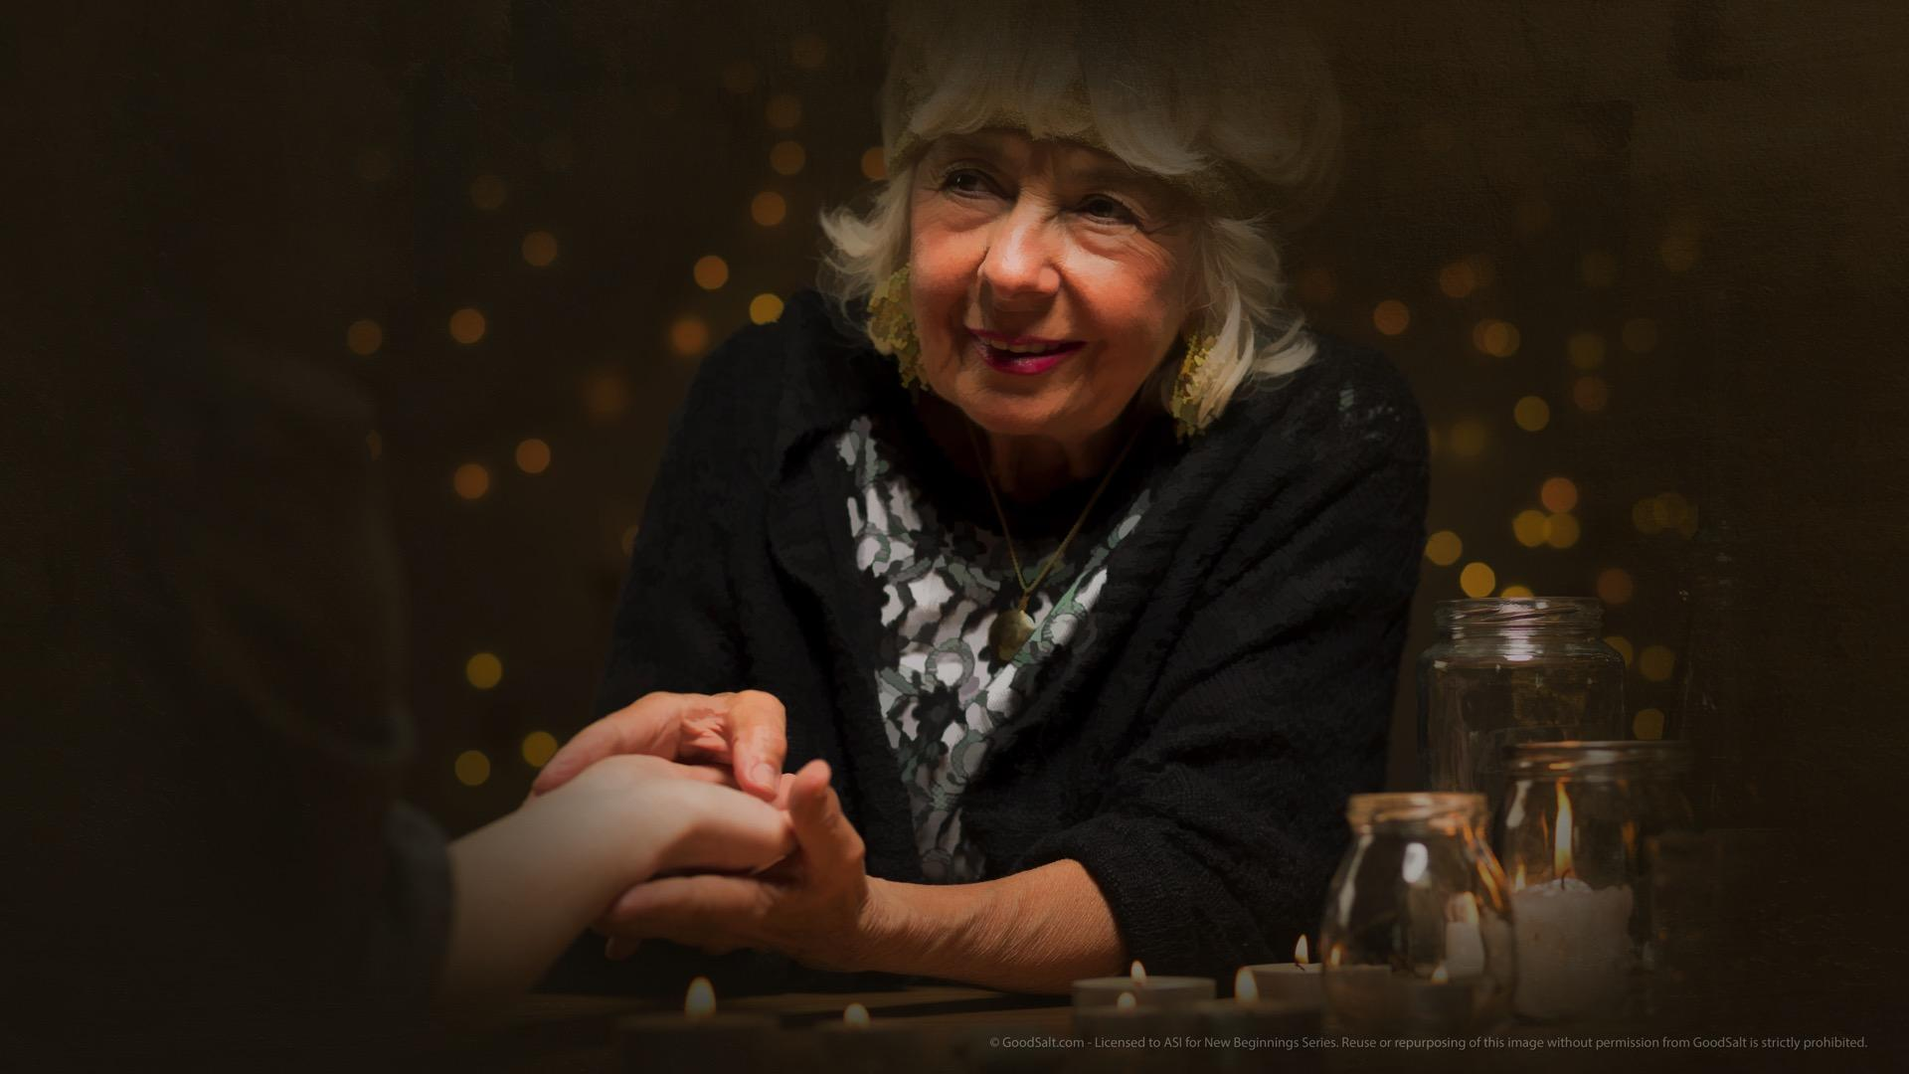
Notes:
But are the psychics and mediums actually able to put us in touch with the souls of loved ones we’ve lost in death? Can the spirits of the dead take possession of living people, using their bodies, voices, and minds to act and speak?

Slide 4
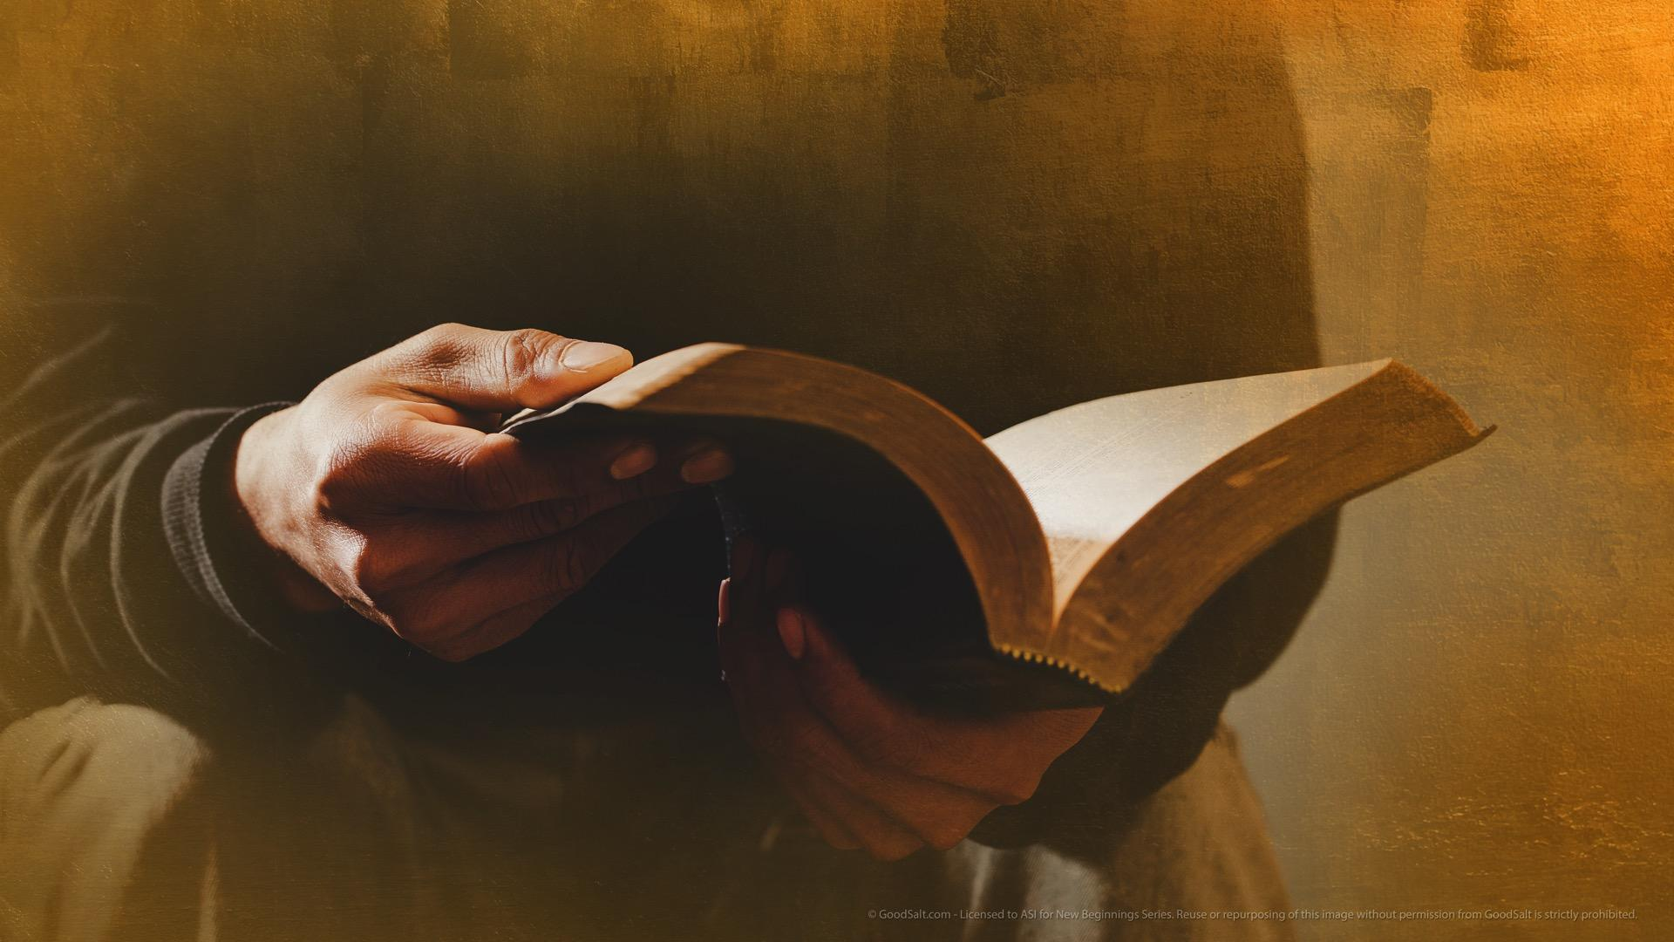
Notes:
This is a very important question. How can we know for absolute certainty that these communications are genuine and real – or false and extremely dangerous? Our eternal salvation may be at stake, so we need to have solid answers we can be confident in. And there’s no more reliable source of answers than God’s word!

Slide 5
Notes:
The Bible is unequivocally clear in its condemnation of spiritism and attempts to communicate with the dead. Notice the warning God gave His people: “Give no regard to mediums and familiar spirits; do not seek after them, to be defiled by them: I am the Lord your God.” Leviticus 19:31.

Slide 6
Notes:
Before Israel entered the Promised Land of Canaan, they were explicitly told, “There shall not be found among you... a witch, or a charmer or a consulter with familiar spirits…

Slide 7
Notes:
…or a wizard or a necromancer. For all that do these things are an abomination unto the LORD....” Deuteronomy 18:10-12, KJV.

Slide 8
Notes:
God knew that people who consult with the “spirits” would mislead His people, so He told them this: “You shall not permit a sorceress [witch] to live.” Exodus 22:18.

Slide 9
Notes:
The experience of King Saul in consulting a spirit medium demonstrates the folly of trying to speak to the dead. “So Saul died for his unfaithfulness which he had committed…

Slide 10
Notes:
…and also because he consulted a medium for guidance.” 1 Chronicles 10:13.

Slide 11
Notes:
But why would God want to prevent us from communicating with the dead? Doesn’t He understand our need for comfort and guidance?

Slide 12
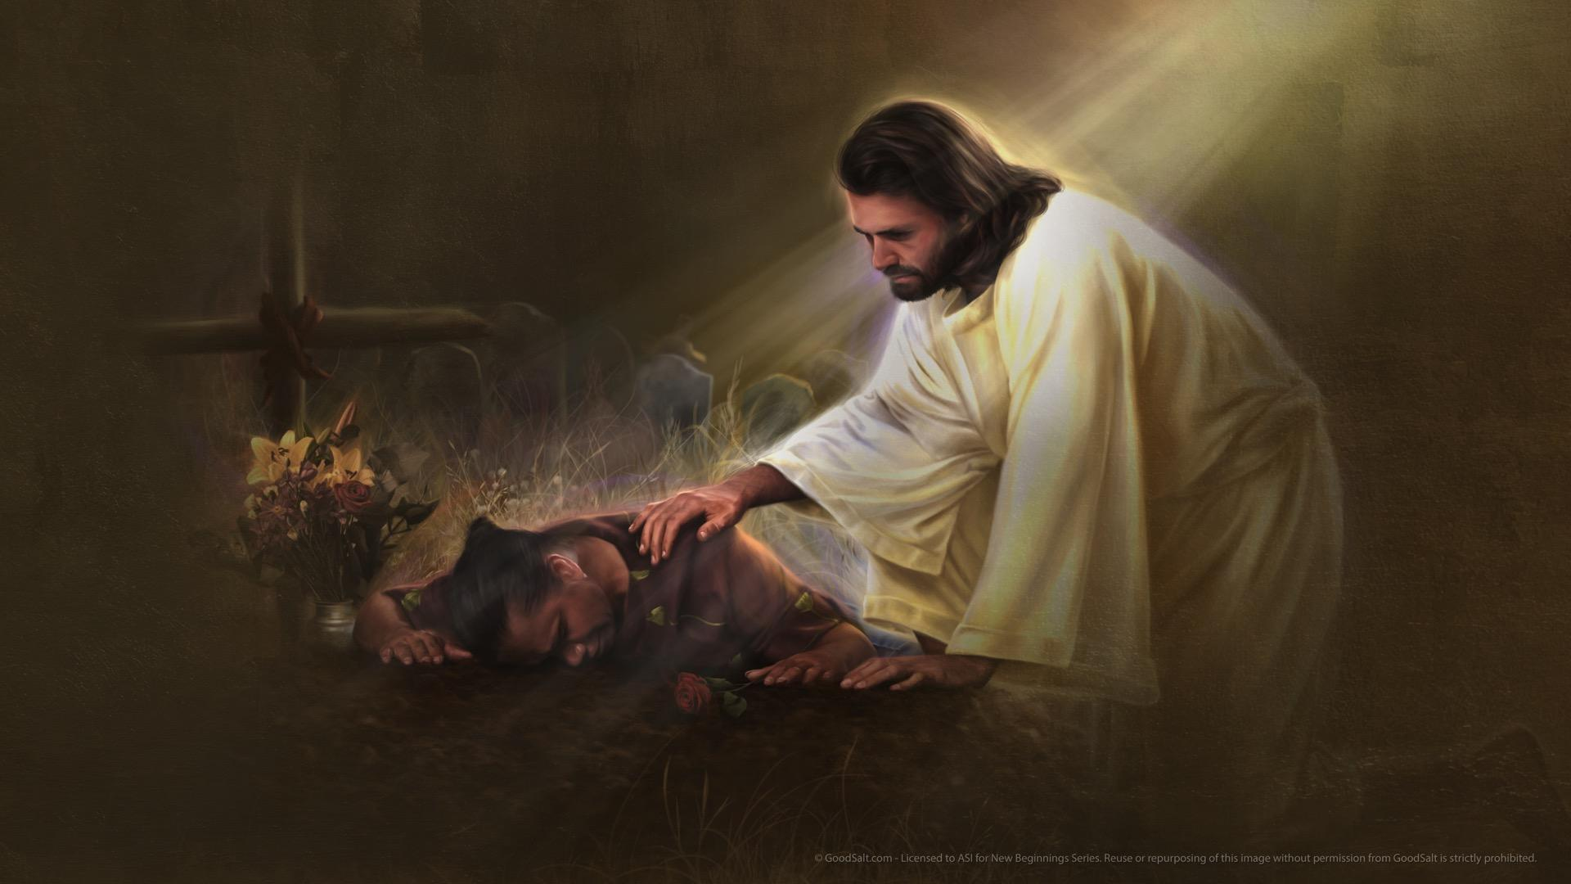
Notes:
God wants the very best for His people. His heart of love is pained when we are mourning the loss of someone dear to us. He sees even the sparrow that falls, so we know that He cares about everything that concerns us. He is touched with our grief.

Slide 13
Notes:
At the funeral of his friend Lazarus, the Bible says that “Jesus wept.” John 11:35. He longs to bring us comfort and hope. One thing we can be sure about: Jesus does not withhold any good thing from His children! So why does the Bible prohibit communication with our departed friends and loved ones?

Slide 14
Notes:
One thing is certain: Jesus knows more about life and death that anyone else who has lived on Planet Earth. “Do not be afraid,” He says, “I am the First and the Last. I am He who lives, and was dead,

Slide 15
Notes:
…and behold, I am alive forever more. Amen. And I have the keys of Hades and of Death.” Revelation 1:17, 18.

Slide 16
Notes:
Not only did Jesus pass through death and now lives, but He also is the Lifegiver – both abundant life here in this world and after this life is over. “I have come that they may have life, and that they may have it more abundantly.” John 10:10.

Slide 17
Notes:
He told Martha after her brother had passed away, “I am the resurrection and the life. He who believes in Me, though he may die, he shall live.” John 11:25.

Slide 18
Notes:
No one knows more about an invention or creation than the one who made it. And Jesus is the Creator God! “In the beginning was the Word, and the Word was with God, and the Word was God....

Slide 19
Notes:
All things were made through Him, and without Him nothing was made that was made” (John 1:1-3)

Slide 20
Notes:
“For by Him all things were created... All things were created through Him and for Him” (Colossians 1:16). The Creator-God must know something about life and death and what’s best for us! And, in fact, He makes it pretty clear why He prohibited us from communicating with the dead: because it is impossible!

Slide 21
Notes:
The Bible clearly states that the deceased do not return to communicate with the living. “As the cloud disappears and vanishes away. So he who goes down to the grave does not come up.

Slide 22
Notes:
He shall never return to his house, nor shall his place know him anymore.” Job 7:9, 10.

Slide 23
Notes:
How much knowledge can the dead communicate to us? Ecclesiastes states plainly: “For the living know that they will die, but the dead know nothing.” Ecclesiastes 9:5. From the teachings of God’s word, we conclusively know that the living cannot communicate with the dead.

Slide 24
Notes:
You may be asking, then, “If the dead or not conscious, who are the ‘spirits’ that do speak to the living?” The Bible answers this question as well. “And I saw three unclean spirits like frogs coming out of the mouth of the dragon [Satan],

Slide 25
Notes:
…out of the mouth of the beast and out of the mouth of the false prophet.

Slide 26
Notes:
For they are spirits of demons [fallen angels], performing signs, which go out to the kings of the earth,

Slide 27
Notes:
…and of the whole world, to gather them to the battle of the great day of God Almighty.” Revelation 16:13, 14.

Slide 28
Notes:
The Bible goes further in describing for us just where these demons came from and what their purpose is now. “And war broke out in heaven: Michael and his angels fought with the dragon;

Slide 29
Notes:
…and the dragon and his angels fought, but they did not prevail, nor was a place found for them in heaven any longer.

Slide 30
Notes:
So the great dragon was cast out, that serpent of old, called the Devil and Satan,

Slide 31
Notes:
…who deceives the whole world; he was cast to the earth, and his angels were cast out with him.” Revelation 12:7-9

Slide 32
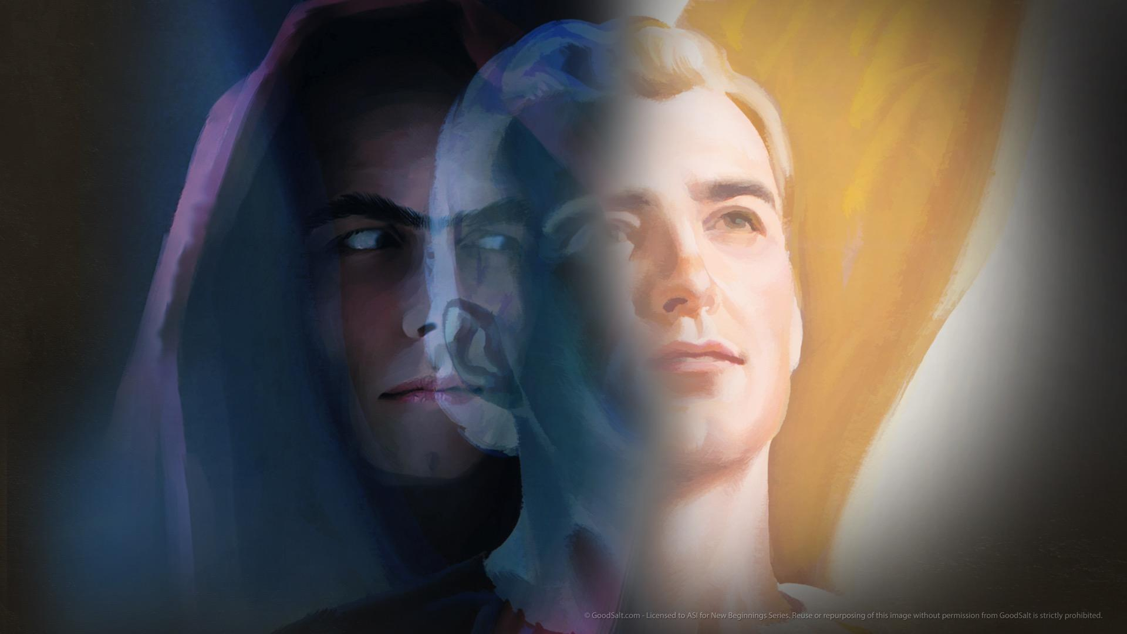
Notes:
No wonder the Bible tells us not to speak with the “spirits” who are claiming to be our departed loved ones! Those “spirits” or demons, as the Bible refers to them, are actually fallen angels whose purpose it is along with Satan to deceive the whole world! Their purpose is not primarily to bring you comfort and hope, but to turn you away from Jesus and the truth of God’s word and cause you to lose your eternal salvation! Communication with these spirits is nothing to play with. And if you don’t understand this important teaching of the Bible, you are vulnerable and at risk of a terribly attractive deception!

Slide 33
Notes:
You see, Satan’s deceptive power is so great that he can impersonate others. He even has the ability to appear as a good angel! “And no wonder! For Satan himself transforms himself into an angel of light.” 2 Corinthians 11:14.

Slide 34
Notes:
This is how these mediums can put people in touch with “their loved one” who looks, talks, and acts like the person they knew before their death. Satan and his evil angels are intimately acquainted with our traits and personalities. They can impersonate perfectly every person who has ever lived. It is absolutely frightening to realize that good people can be thus deceived and drawn into Satan’s influence, all the while thinking that they are enjoying the comfort of speaking with a departed loved one!

Slide 35
Notes:
But these verses reveal deception that could be even greater still: Satan will seek to impersonate Jesus himself! Can you imagine how many will be deceived, who do not know what the Bible teaches about the Second Coming? This is why Jesus gave such a serious warning about this very thing: “Take heed that no one deceives you. For many will come in My name, saying, ‘I am the Christ,’ and will deceive many.” Matthew 24:4, 5.

Slide 36
Notes:
Evidently the risk is great, because Jesus repeated the same warning in the same sermon. “Then if anyone says to you, ‘Look, here is the Christ!’ or ‘There!’ do not believe it.

Slide 37
Notes:
For false christs and false prophets will rise and show great signs and wonders

Slide 38
Notes:
…to deceive, if possible, even the elect. See, I have told you beforehand.” Matthew 24:23-25.

Slide 39
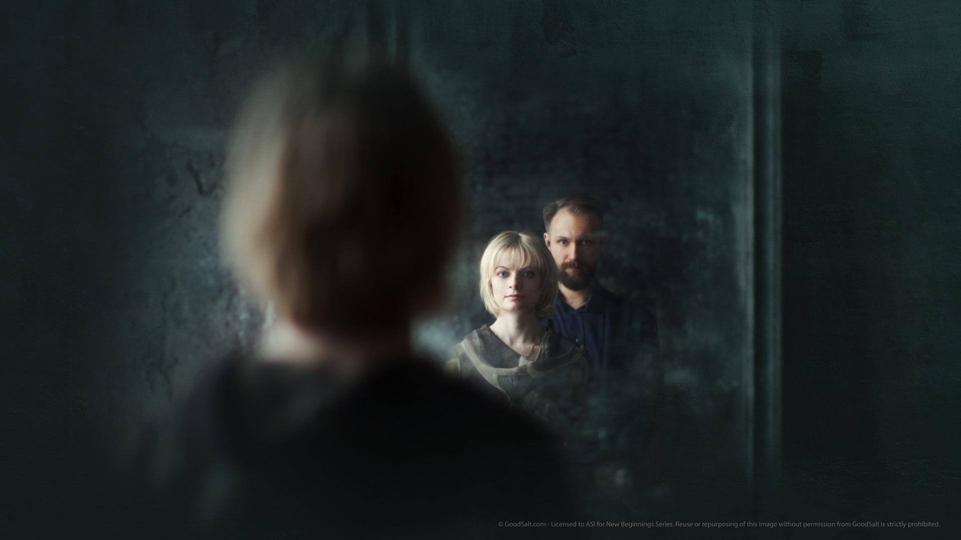
Notes:
Despite all these warnings in the Bible, many people still choose to believe what their hearts and senses are telling them. “I have seen a departed loved one, they’re still alive in spirit,” someone may say. “I have talked to my departed husband,” another believes. “I lost my son in a terrible accident, but I visit and talk to him; he is a great comfort to me,” yet another claims. There’s no doubt they are talking to and seeing someone, but the Bible is clear that those who have claims such as these are deceived. Jesus warned us it would happen! The only way not to be deceived is to believe God’s word even over what our five senses and our feelings are telling us! Are we going to believe what the Bible says, or the miraculous impersonations and deceptions of Satan? Only those who have fortified their minds with the words of the Bible will be able to stand strong against the overwhelming tide of deception that is already flooding the world.

Slide 40
Notes:
But what about near-death experiences, in which people who have been clinically dead have been revived? Some report that they found themselves hovering in the hospital room looking down at their own bodies. Others claim to have seen a bright light and Jesus or an angel beckoning them to follow. Still others report seeing a loved one who previously died waiting for them on the other side. While there are a number of ways to explain such experiences, including the effects of medications and oxygen deprivation, there is no way to reconcile these stories with the Bible’s account of what death is like. Our only safety is in studying and believing God’s Word!

Slide 41
Notes:
What about other religions, and their beliefs about death? Millions believe in reincarnation – that after a person dies he may be reborn as a different animal, such as a cow or rat or snake. He may also be reborn as another human – perhaps rich, perhaps poor and blind, deaf, or crippled. And reincarnation cannot be separated from the idea of karma, in which one’s choices and behavior will be inevitably rewarded in exact and just fashion. In this manner justice will be served and things set right. Of course, this is in contrast to what the Bible teaches about the judgment, in which a loving God brings justice and fairness to this universe.

Slide 42
Notes:
What about the end goal of these teachings? Hinduism and Buddhism teach the goal is Nirvana, “A state of peaceful nothingness, with no personality, no intelligence, no memory, no ‘you’ as a person, no ability to think and love and feel and to have conscious joy.”

Slide 43
Notes:
What a difference between these teachings and what the Bible says about God’s plan for our eternal life! Jesus said, “I have come that they may have life, and that they may have it more abundantly.” John 10:10.

Slide 44
Notes:
The apostle Paul, when speaking of life in eternity, describes it as being much more full and real and personal than even life here and now. “For now we see in a mirror, dimly, but then face to face.

Slide 45
Notes:
Now I know in part, but then I shall know just as I also am known.” 1 Corinthians 13:12.

Slide 46
Notes:
I am thankful for Jesus, aren’t you? I’m thankful for the wonderful hope that He brings! Evil will not always prevail. All history is moving towards a time when God will create a new earth for real people without sin, disease, war, food shortages, suffering, or death. “Now I saw a new heaven and a new earth, for the first heaven and the first earth had passed away.

Slide 47
Notes:
Also there was no more sea. Then I, John, saw the holy city, New Jerusalem, coming down out of heaven from God,

Slide 48
Notes:
…prepared as a bride adorned for her husband. And I heard a loud voice from heaven saying,

Slide 49
Notes:
‘Behold, the tabernacle of God is with men, and He will dwell with them, and they shall be His people.

Slide 50
Notes:
God Himself will be with them and be their God. And God will wipe away every tear from their eyes;

Slide 51
Notes:
…there shall be no more death, nor sorrow, nor crying. There shall be no more pain, for the former things have passed away.’” Revelation 21:1-4.

Slide 52
Notes:
I want to be there in that day, don’t you? The secret to being a part of God’s new kingdom is being “reborn.” Not after death, when it will be too late. Not through endless “wheel of life” reincarnations. But now! Today! “Blessed be the God and Father of our Lord Jesus Christ, who according to His abundant mercy

Slide 53
Notes:
…has begotten us again to a living hope through the resurrection of Jesus Christ from the dead,

Slide 54
Notes:
…to an inheritance incorruptible and undefiled that does not fade away, reserved in heaven for you.” 1 Peter 1:3, 4.

Slide 55
Notes:
By being born again through Jesus Christ you can have everlasting life. That is the assurance that God wants you to have today! “And this is the testimony: that God has given us eternal life, and this life is in His Son.

Slide 56
Notes:
He who has the Son has life; he who does not have the Son of God does not have life.” 1 John 5:11, 12.

Slide 57
Notes:
How can we be sure? How do we know if eternal life is ours? Listen as John makes it clear: “These things I have written to you who believe in the name of the Son of God, that you may know that you have eternal life....” 1 John 5:13.

Slide 58
Notes:
…that you may know that you have eternal life....” 1 John 5:13.

Slide 59
Notes:
The questions that each person must answer is, “Do I have Jesus?” You can have Him at this very moment. He wants to be your Savior and Friend. He’s not passively waiting for you to figure out your salvation on your own. No! He’s actively working to draw you into a saving relationship with Him. He loves you! He wants to spend eternity with you! He says, “Behold, I stand at the door and knock. If anyone hears my voice and opens the door,

Slide 60
Notes:
I will come in to him and dine with him, and he with Me.” Revelation 3:20.

Slide 61
Notes:
Yes, my friends, there’s one voice beyond the grave that is speaking to us. That’s the voice of Jesus, the One who died for us but rose from the dead! He’s speaking to your heart and mine tonight. He’s asking us to trust Him. He’s warning us against listening to other voices – voices of deception. And He’s asking if we will just open our heart’s door and let Him in. Don’t you want to hear His voice right now? Don’t you want His assurance of eternal life, His assurance of the life He has planned for you? Would you like to kneel with me as we pray tonight? Just open the door of your heart right now, and invite Him in as we pray.

